Slide 1
Software Testing and Quality Assurance Theory and Practice Chapter 7 System Integration Testing
Notes:
------------------------------------------------------------------
------------------------------------------------------------------
-------------------------------------------------------------------
--------------------------------------------------------------------
1

Slide 2
The Concept of Integration Testing
A software module is a self-contained element of a system
Modules are individually tested commonly known as unit testing
Next major task is to put the modules, i.e., pieces together to construct the complete system
Construction of a working system from the pieces is not a straightforward task because of numerous interface errors
The objective of system integration testing (SIT) is to build a “working” version of the system
Putting modules together in an incremental manner
Ensuring that the additional modules work as expected without disturbing the functionalities of the modules already put together
Integration testing is said to be complete when
The system is fully integrated together
All the test cases have been executed
All the severe and moderated defects found have been fixed

Slide 3
The Concept of Integration Testing
The major advantages of conducting SIT are as follows:
Defects are detected early
It is easier to fix defects detected earlier
We get earlier feedback on the health and acceptability of the individual modules and on the overall system
Scheduling of defect fixes is flexible, and it can overlap with development.
System integration testing is a systematic technique for assembling a software system while conducting tests to uncover errors associated with interfacing.
Large, complex software products can go through several iterations of build-and-test cycles before they are fully integrated.

Slide 4
DIFFERENT TYPES OF INTERFACES AND INTERFACE ERRORS
An interface between two modules allows one module to access the service provided by the other.
Three common paradigms for interfacing modules are as follows:
Procedure Call Interface: A procedure in one module calls a procedure in another module. The caller passes on control to the called module. The caller can pass data to the called procedure, and the called procedure can pass data to the caller while returning control back to the caller.
Shared Memory Interface: A block of memory is shared between two
modules. The memory block may be allocated by one of the two modules or a third module. Data are written into the memory block by one module and are read from the block by the other.
Message Passing Interface: One module prepares a message by initializing the fields of a data structure and sending the message to another module. This form of module interaction is common in client–server-based systems
and web-based systems.

Slide 5
DIFFERENT TYPES OF INTERFACES AND INTERFACE ERRORS
Element | Description
Module 1 (Caller) | CheckoutController (Handles user interaction)
Module 2 (Called) | InventoryService (Manages stock levels)
Interface Channel | Direct function/method invocation (e.g., in Python, Java, or C++)
Interaction | The CheckoutController calls a method in the InventoryService module.
Control/Data Flow | 1. Caller passes control: CheckoutController calls InventoryService.reserve_stock(sku, quantity). 2. Called performs service: InventoryService checks and updates the database. 3. Called returns data & control: InventoryService returns True (success) or False (out of stock) and gives control back to the CheckoutController.
Testing Focus | Testing must ensure the correct data types are passed and that the return value is accurately interpreted (e.g., if the service returns False, the controller displays the correct "Out of Stock" message).
Notes:
Procedure Call Interface (Local Control Transfer)
This is the most common and traditional form of interfacing. It involves one function explicitly invoking another, passing control and data directly across a boundary (often within the same process or application).

Slide 6
DIFFERENT TYPES OF INTERFACES AND INTERFACE ERRORS
Element | Description
Module 1 (Writer) | MarketDataFeedProcessor (Pulls real-time prices from an exchange)
Module 2 (Reader) | TradingStrategyEngine (Calculates buy/sell signals)
Interface Channel | A dedicated, mutually accessible Shared Memory Buffer (a specific address in RAM).
Interaction | The two modules do not call each other; they access the shared memory concurrently.
Control/Data Flow | 1. Writer: The Processor writes the latest stock price for $XYZ$ into a specific, pre-agreed slot in the shared buffer. 2. Reader: The Engine constantly reads the data from that same slot to trigger a trade decision.
Testing Focus | Testing must focus on synchronization and concurrency errors (e.g., deadlocks, race conditions, or one module overwriting data before the other module has finished reading it). The data structure within the shared block must be perfectly aligned between modules.
Notes:
Shared Memory Interface (Direct Data Access)
This is a high-performance method where two modules (often separate processes) bypass typical communication protocols to read and write data to the same designated block of computer memory. This is common in operating systems, gaming, and high-speed data processing applications.

Slide 7
DIFFERENT TYPES OF INTERFACES AND INTERFACE ERRORS
Element | Description
Module 1 (Sender) | TicketCreationService (Responds to the user and creates a ticket record)
Module 2 (Receiver) | NotificationService (Sends emails and updates Slack channels)
Interface Channel | A Message Queue (MQ) or REST API Endpoint (e.g., RabbitMQ, SQS, or HTTPS).
Interaction | The sender sends a message/request and immediately continues its work. The receiver picks up the message when ready.
Control/Data Flow | 1. Sender: TicketCreationService initializes a JSON data structure ({ "ticket_id": 456, "status": "new" }). 2. Sender: It sends this JSON message to the NotificationService's designated endpoint (e.g., POST /api/notify). 3. Receiver: The NotificationService receives the message and executes its tasks (sends email, updates Slack).
Testing Focus | Testing must ensure the message payload (data structure) is correctly formatted and that the receiver handles the communication protocol errors (e.g., network timeout, invalid JSON structure). This also includes testing queue capacity and message loss.
Notes:
3. Message Passing Interface (Asynchronous Communication)
This is the dominant paradigm in distributed systems, web services, and microservices architecture. Modules communicate by sending structured messages, often asynchronously, meaning the sender doesn't wait for the recipient to process the request immediately.

Slide 8
DIFFERENT TYPES OF INTERFACES AND INTERFACE ERRORS
It is difficult to observe interface errors by performing system-level testing, because these errors tend to be buried in system internals?
System integration testing is performed by the system integration group, also known as a build engineering group. The integration test engineers need to know the details of the software modules.
This means that the team of engineers who built the modules needs to be involved in system integration.
The integration testers should be familiar with the interface mechanisms.
The system architects should be involved in the integration testing of complex software systems because of the fact
that they have the bigger picture of the system.

Slide 9
Granularity of System Integration Testing
Integration testing includes both white- and black-box testing approaches.
System Integration testing is performed at different levels of granularity
Intra-system testing
This form of testing constitutes low-level integration testing with the objective of combining the modules together to build a cohesive system
Inter-system testing
It is a high-level testing phase which requires interfacing independently tested systems
Pairwise testing
In pairwise integration, only two interconnected systems in an overall system are tested at a time
The purpose of pairwise testing is to ensure that two systems under consideration can function together, assuming that the other systems within the overall environment behave as expected

Slide 10
System Integration Techniques
Common approaches to perform system integration testing
Incremental
Top-down
Bottom-up
Sandwich
Big-bang
Pre-requisite
A module must be available to be integrated
A module is said to available for combining with other modules when the module’s check-in request form is ready
Notes:
Integration testing need not wait until all the modules of a system are
coded and unit tested. Instead, it can begin as soon as the relevant modules are
available.
This form typically requires sign-offs and verification that the following tasks are complete:
Unit Testing Complete: All individual functions within the module have been covered by unit tests, and they all pass.
Code Review Sign-off: The code has been formally reviewed by a peer, and all issues have been resolved.
Documentation Complete: The module's interface (API) and any special configuration steps are clearly documented.
Baseline Status: The code is stable and meets the project's definition of "ready."

Slide 11
Incremental
A software image is a compiled software binary
A build is an interim software image for internal testing within an organization
Constructing a build is a process by which individual modules are integrated to form am interim software image.
The final build is a candidate for system testing
Constructing a software image involves the following activities
Gathering the latest unit tested, authorized versions of modules
Compiling the source code of those modules
Checking in the compiled code to the repository
Linking the compiled modules into subassemblies
Verifying that the subassemblies are correct
Exercising version control
Notes:
We might compare it to building a bicycle:The Modules are the individual parts: the chain, the pedals, and the gears.The Subassembly is the "Drivetrain"—the pedals and chain linked together. You verify that the chain moves when you push the pedals before you attach it to the frame and wheels (the final build).
In the context of incremental system integration, exercising version control is the process of managing, tracking, and securing the different versions of both the individual modules and the resulting subassemblies. It ensures that the integration team is always working with authorized code and can "undo" an integration step if it introduces a critical failure.

Slide 12
Incremental
Integration testing is conducted in an incremental manner as a series of test cycles
In each test cycle, a few more modules are integrated with an existing and tested build to generated larger builds
The complete system is built, cycle by cycle until the whole system is operational for system-level testing.
The number of SIT cycles and the total integration time are determined by the following parameters:
Number of modules in the system
Relative complexity of the module
Relative complexity of the interfaces between the modules
Number of modules needed to be clustered together in each test cycle
Whether the modules to be integrated have been adequately tested before
Turnaround time for each test-debug-fix cycle

Slide 13
Incremental
A release note (Status Report) containing the following information accompanies a build.
What has changed since the last build?
What outstanding defects have been fixed?
What are the outstanding defects in the build?
What new modules, or features, have been added?
What existing modules, or features, have been enhanced, modified, or deleted?
Are there any areas where unknown changes may have occurred?
A test strategy is created for each new build and the following issues are addressed while planning a test strategy
What test cases need to be selected from the SIT test plan?
What previously failed test cases should now be re-executed in order to test the fixes in the new build?
How to determine the scope of a partial regression tests?
What are the estimated time, resource deman, and cost to test this build?
Notes:
What test cases need to be selected from the system integration test plan,
as discussed in Section 7.6, in order to test the changes? Will these test
cases give feature coverage of the new and modified features? If necessary,
add new test cases to the system integration test plan.
What existing test cases can be reused without modification in order to
test the modified system? What previously failed test cases should now be
reexecuted in order to test the fixes in the new build?
How should the scope of a partial regression test be determined? A full
regression test may not be run on each build because of frequent turnaround
of builds. At the least, any earlier test cases which pertain to areas that
have been modified must be reexecuted.
What are the estimated time, resource demand, and cost to test this build?
Some builds may be skipped based on this estimate and the current activities, because the integration test engineers may choose to wait for a later
build.

Slide 14
Incremental
Creating a daily build is very popular among many organization
It facilitates to a faster delivery of the system
It puts emphasis on small incremental testing
It steadily increases number of test cases
The system is tested using automated, re-usable test cases
An effort is made to fix the defects that were found within 24 hours
Prior version of the build are retained for references and rollback
A typical practice is to retain the past 7-10 builds
Notes:
The "Integration Loop": How they work together
Git holds the Authorized Modules in a central repository.
A developer merges a module into the integration branch.
CI detects this change, pulls the code, compiles it, and links it into a new subassembly.
CI runs the Verification tests.
If successful, Git "tags" the subassembly as a stable Build.
CD deploys the build for further System Testing.

Slide 15
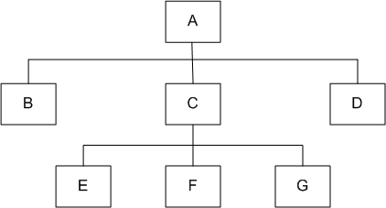
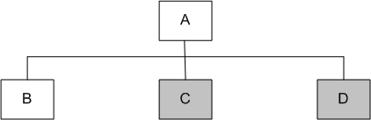
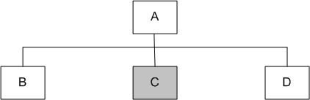
Top-down
Module A has been decomposed into modules B, C, and D
Modules B, D, E, F, and G are terminal modules
First integrate modules A and B using stubs C` and D` (represented by grey boxes)
Next stub D` has been replaced with its actual instance D
Two kinds of tests are performed:
Test the interface between A and D
Regression tests to look for interface defects between A and B in the presence of module D
Figure 7.1: A module hierarchy with three levels and seven modules
Figure 7.2: Top-down integration of modules A and B
Figure 7.3: Top-down integration of modules A, B and D

Slide 16
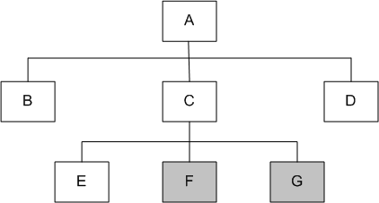
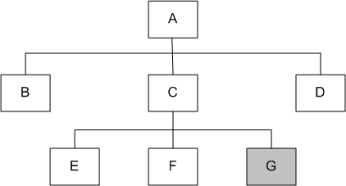
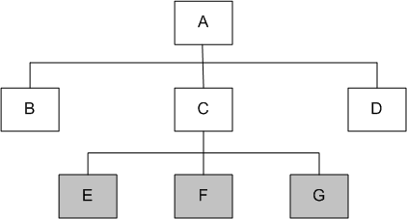
Top-down
Stub C` has been replaced with the actual module C, and new stubs E`, F`, and G`
Perform tests as follows:
first, test the interface between A and C;
second, test the combined modules A, B, and D in the presence of C
The rest of the process depicted in the right hand side figures.
Figure 7.5: Top-down integration of modules A, B, C, D and E
Figure 7.6: Top-down integration of modules A, B, C, D, E and F
Figure 7.4: Top-down integration of modules A, B, D and C

Slide 17
Top-down
Advantages
The SIT engineers continually observe system-level functions as the integration process continue
Isolation of interface errors becomes easier because of the incremental nature of the top-down integration
Test cases designed to test the integration of a module M are reused during the regression tests performed after integrating other modules
Disadvantages
It may not be possible to observe meaningful system functions because of an absence of lower level modules and the presence of stubs.
Test case selection and stub design become increasingly difficult when stubs lie far away from the top-level module.
Notes:
Advantages Example: You integrate the Registration GUI with a stub for the Course Catalog. Even though the database isn't ready, the SIT engineer can already verify the "look and feel" and ensure the "Register" button correctly triggers the next screen. This builds immediate confidence that the user's primary "Trigger" works
Example: You add the Section Validator module to the existing UI. If the system now crashes when a student selects a time slot, you know the error is likely in the interface between the UI and the new Validator
Example: You create a test case: "Student selects Math 101 and clicks Register." You run this when integrating the UI. Later, when you integrate the Payment Gateway, you run that exact same "Math 101" test again to make sure the new payment code didn't break the basic registration flow. Disadvantages Example: If you integrate the Main Menu and Login first, but use stubs for Enrollment, Prerequisites, and Grading, the student cannot actually "complete" a registration. The system is just a series of empty menus. You haven't observed the "Success End Condition" (the student being added to the list) because the logic-heavy modules are at the bottom. Example: Imagine a stub for the Database is four levels below the GUI. To test how the system handles a "Database Timeout," the tester must figure out a very specific sequence of inputs at the GUI level that will travel through the "Authentication," "Session Manager," and "Course Logic" layers just to reach that deep stub. If those middle layers have their own validation, it becomes an "input-output" puzzle just to trigger a simple error.

Slide 18
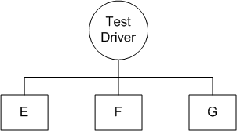
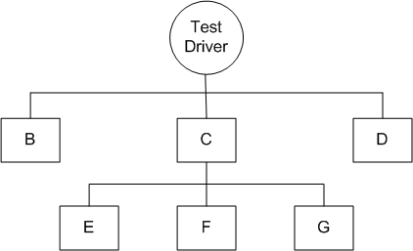
Bottom-up
We design a test driver to integrate lowest-level modules E, F, and G
Return values generated by one module is likely to be used in another module
The test driver mimics module C to integrate E, F, and G in a limited way.
The test driver is replaced with actual module , i.e., C.
A new test driver is used
At this moment, more modules such as B and D are integrated
The new test driver mimics the behavior of module A
Finally, the test driver is replaced with module A and further test are performed
Figure 7.8: Bottom-up integration of module E, F, and G
Figure 7.9: Bottom-up integration of module B, C, and D with F, F, and G

Slide 19
Advantages
One designs the behavior of a test driver by simplifying the behavior of the actual module
If the low-level modules and their combined functions are often invoked by other modules, then it is more useful to test them first so that meaningful effective integration of other modules can be done
Disadvantages
Discovery of major faults are detected towards the end of the integration process, because major design decision are embodied in the top-level modules
Test engineers can not observe system-level functions from a partly integrated system. In fact, they can not observe system-level functions until the top-level test driver is in place
Notes:
Advantages: Examples
Example: To test the Database Connector module, you don't need the complex "Register for a Course" UI. You simply write a Test Driver (a small piece of code) that sends a specific Course ID (e.g., "Math 1060") to the module and verifies that it correctly returns the course details. It is much easier to write this "dummy" caller than to simulate the complex responses a database would provide in a top-down stub.
Example: In the University System, the Audit Logger module (which records every transaction) is used by Registration, Grading, and Billing. By testing this low-level module first, you ensure the core "logging" foundation is bug-free. This provides a stable environment for the more complex modules that will be integrated later and rely on this service.
Disadvantages: Examples
Example: You have integrated the Database, the Section Validator, and the Enrollment logic perfectly. At the very end, you integrate the Top-Level UI. Only then do you realize the UI design requires a "Real-time Seat Counter" that your low-level architecture doesn't support. Because this structural flaw is found at the end, you have to rewrite several "finished" modules.
Example: You have integrated 80% of the back-end code for the "Register for a Course" use case. However, without the Top-Level GUI, you cannot actually perform a "Registration" from a user's perspective. To a stakeholder or student, the system doesn't "exist" yet because the trigger (the UI button) is the last piece to be added.

Slide 20
Big-bang and Sandwich
Big-bang Approach
First all the modules are individually tested
Next all those modules are put together to construct the entire system which is tested as a whole
Sandwich Approach
In this approach a system is integrated using a mix of top-down, bottom-up, and big-bang approaches
A hierarchical system is viewed as consisting of three layers
The bottom-up approach is applied to integrate the modules in the bottom-layer
The top layer modules are integrated by using top-down approach
The middle layer is integrated by using the big-bang approach after the top and the bottom layers have been integrated

Slide 21
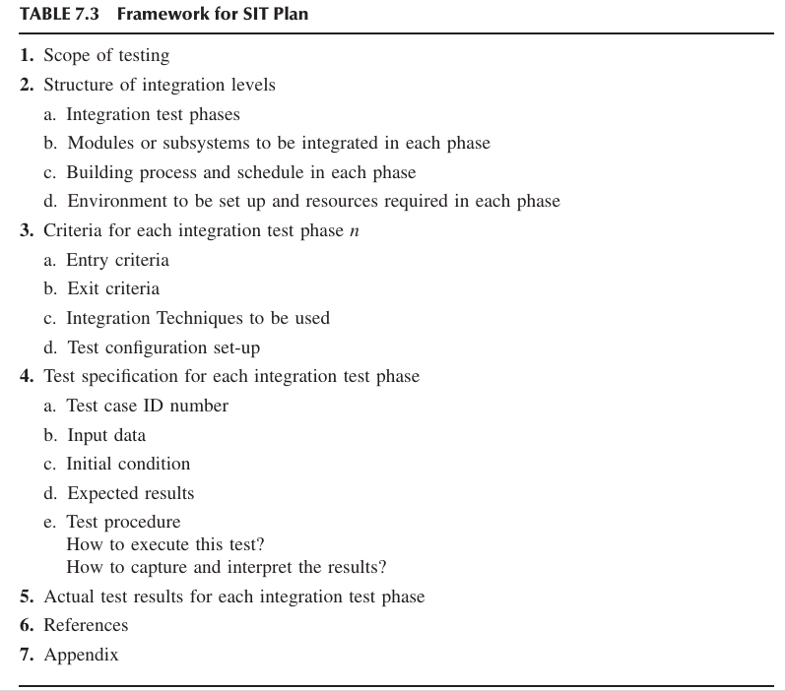
Test Plans for System Integration

Slide 22
Framework for SIT
Scope of testing: In the scope of testing section, one summarizes the system architecture.
Functional, internal, and performance characteristics
Structure of integration levels
Integration test phases
division of integration testing into different phases, such as functional (interface check), end-to-end, and endurance phases (reliability).
Modules or subsystems to be integrated in each phase
Building process and schedule in each phase
Daily, weekly, monthly build etc
Environment to be setup and resources required in each phase
Notes:
1. Functional Characteristics (The "What")
This focus involves testing the services provided by the integrated modules. The architecture summary identifies which module provides a specific function (e.g., an API endpoint) and which modules consume that function.
Testing Goal: To verify that the service being accessed (e.g., InventoryService.reserve_stock()) performs its intended business function correctly, accepting the right inputs and producing the right outputs.
2. Internal Characteristics (The "How")
This focus is on the technical interface mechanism that links the modules (the channels we previously discussed).
Testing Goal: To ensure the technical communication layer is robust. This includes validating the integrity of the Message Payload (Message Passing Interface), testing Synchronization (Shared Memory Interface), and verifying Data Typing (Procedure Call Interface). Errors here are typically integration bugs (e.g., a service sends a JSON object, but the receiving service expects XML).
3. Performance Characteristics (The "Efficiency")
This focus involves assessing the performance implications of the interfaces themselves.
Testing Goal: To identify potential bottlenecks where integrated components slow down the overall system. For example, if a Use Case involves 10 sequential RESTful API calls between subsystems (Message Passing), the test summary must flag that integration point for latency and throughput measurement, ensuring the interfaces don't introduce unacceptable delays.

Slide 23
Framework for SIT
3. Criteria for each integration test phase n
1. Entry Criteria
Start date + Table 7.4
2. Exit Criteria
End date + Table 7.4
3. Integration technique to be used
top down or bottom up
4. Test configuration setup

Slide 24
Framework for SIT
4. Test specification for each integration test phase
1. Test Case ID Number
2. Input Data
3. Initial Condition
4. Expected results
5. Test procedure
How to execute this test?
How to capture and interpret the results?
5. Actual test results for each integration test phase
6. References
7. Appendix

Slide 25
Framework for SIT
System integration testing is performed in phases of increasing complexity for better efficiency and effectiveness.
In the first phase interface integrity and functional validity within a system are tested.
In the second phase end-to-end and pairwise tests are conducted.
Finally, in the third phase, stress and endurance tests are performed.
The categories of system integration tests and the corresponding test cases discussed below are applicable for the different test phases.

Slide 26
The categories of system integration tests
Interface Integrity: Internal and external interfaces are tested as each module is integrated into the structure.
When two modules are integrated, the communication between them is called internal, whereas when they communicate with the outside environment, it is called external.
The number of parameters sent in a message agree with the number of parameters expected to be received. • The parameter order in the messages match the order expected. • The field sizes and the data types match. • The boundaries of each data field in a message match the expected bound aries. • When a message is generated from stored data prior to being sent, the message truly reflects the stored data. • When a received message is stored, data copying is consistent with the received message.

Slide 27
The categories of system integration tests
Functional Validity: Tests are designed to uncover functional errors in each module after it is integrated with the system. Errors associated with local or global data structures are uncovered with such tests. Selected unit tests that were designed for each module are reexecuted during system integration by replacing the stubs with their actual modules.
End-to-End Validity: Tests are performed to ensure that a completely integrated system works together from end to end. Interim checkpoints on an end-to-end flow provide a better understanding of internal mechanisms. This helps in locating the sources of failures.

Slide 28
The categories of system integration tests
Pairwise Validity: Tests are performed to ensure that any two systems work properly when connected together by a network. The difference between pairwise tests and end-to-end tests lies in the emphasis and type of test cases. For example, a toll-free call to an 800 number is an end-to-end test of a telephone system, whereas a connectivity test between a handset and local private branch exchange (PBX) is apairwise test.
Interface Stress: Stress is applied at the module level during the integration of the modules to ensure that the interfaces can sustain the load. On the other hand, full-scale system stress testing is performed at the time of system-level testing.

Slide 29
The categories of system integration tests
Interface Stress: Stress is applied at the module level during the integration of the modules to ensure that the interfaces can sustain the load. On the other hand, full-scale system stress testing is performed at the time of system-level testing.
Configuration, Logging, CPU Cycles, Memory/Diskate Usage etc.
System Endurance: A completely integrated system is expected to stay up continuously for weeks without any crashes. In the case of communication protocol systems, formal rules govern that two systems communicate with each other via an interface, that is, a communication channel. The idea here is to verify that the format and the message communication across the interface of the modules works for an extended period.

Slide 30
Off-The-Shelf Component Integration
Instead of developing a software component from scratch, organizations occasionally purchase off-the-shelf (OTS) components form third-party vendors and integrate them with their own components
Vigder and Dean [9] have presented elements of an architecture for integration and have defined rules that facilitate integration of components.
They have identified a useful set of supporting components for integrating the actual, serving components. The supporting components are wrappers, glue, and tailoring.
Rine et al. [10] have proposed the concept of adapters to integrate components.
An adapter is associated with each component; the adapter runs an interaction protocol to manage communications among the components.
Components request services from others through their associated adapters.
An adapter is responsible for resolving any syntactic interface mismatch.
Notes:
A wrapper is a piece of code that one builds to isolate the underlying compo nents from other components of the system. Here isolate means putting restrictions around the underlying component to constrain its capabilities. A glue component provides the functionality to combine different components. Component tailoring refers to the ability to enhance the functionality of a component. Tailoring is done by adding some elements to a component to enrich it with a functionality not provided by the vendor. Tailoring does not involve modifying the source code of the component. An example of tailoring is “scripting,” where an application can be enhanced by executing a script upon the occurrence of some event.

Slide 31
Off-The-Shelf Component Integration
A wrapper is a piece of code that one builds to isolate the underlying components from other components of the system.
Here isolate means putting restrictions around the underlying component to constrain its capabilities.
A glue component provides the functionality to combine different components.
Notes:
A wrapper is a piece of code that one builds to isolate the underlying compo nents from other components of the system. Here isolate means putting restrictions around the underlying component to constrain its capabilities. A glue component provides the functionality to combine different components. Component tailoring refers to the ability to enhance the functionality of a component. Tailoring is done by adding some elements to a component to enrich it with a functionality not provided by the vendor. Tailoring does not involve modifying the source code of the component. An example of tailoring is “scripting,” where an application can be enhanced by executing a script upon the occurrence of some event.

Slide 32
Off-the-Shelf Component Testing
Buyer organizations perform two types of testing on an OTS component before purchasing: (i) acceptance testing of the OTS component (ii) integration of the component with other components developed in-house or purchased from a third party.
During integration testing, additional software components, such as a glue or a wrapper, can be developed to bind an OTS component with other components for proper functioning.

Slide 33
Off-the-Shelf Component Testing
Voas [12] proposed three types of testing techniques to determine the suit ability of an OTS component:
Black-Box Component Testing: This is used to determine the quality of the component.
System-Level Fault Injection Testing: This is used to determine how well a system will tolerate a failing component. System-level fault injection does not demonstrate the reliability of the system; instead, it can predict the behavior of the system if the OTS component fails.
Operational System Testing: This kind of test is used to determine the tolerance of a software system when the OTS component is functioning correctly. Operational system testing is conducted to ensure that an OTS component is a good match for the system.

Slide 34
Off-the-Shelf Component Testing
Several related artefacts should be archived and/or modified for each COTS component, because a potential buyer may demand these artifacts to be of high quality
• Individual requirements, including the pointers between the software func tional specification and the corresponding implementations:
The test suite, including the requirement traceability matrix:
The individual pass–fail result of each test case in the test suite:
The details of individual test cases, including input and expected
The system test report corresponding to the final release of the COTS component, which includes performance characteristics, scalability limitation, stability observations, and interoperability of the COTS component:

